Slide 1
Morphology and EDX mapping of Mg_{1-x}Ni_{x}O
S36328 – 2.5%Ni in MgO
Gregor Koch 3rd February 2023

Slide 2
S36328 in comparison to S34869, S35123, S35146
Mg_{1-x}Ni_{x}O
Morphology is invariant compared to analogous samples
Disc-like morphology with narrow disc size distribution
High magnification not clearly indicated small pores in this sample but it is not excluded or must be confirmed in an additional measurement
No indications for any segregated NiO phases (neither EDX nor SEM)
No impurities according to EDX and homogeneous composition
Suggested formulas:
S36328: Ni_{0.037±0.002}Mg_{1±0.043}O_{1.24±0.042}
S34869: Ni_{0.01±0.0004}Mg_{1.00±0.08}O_{1.49±0.07}
S35123: Ni_{0.106±0.004}Mg_{1.00±0.08}O_{2.15±0.06}
S35146: Ni_{0.23±0.01}Mg_{1.00±0.13}O_{1.83±0.07}
Errors due to shadowing in each map (overestimation in perfectly distributed Ni in MgO) can be likely. Variation of results of all maps is given in the little grey table
at% | Map1 | Map2 | map3 | Map4 | mean | sd | rsd / %
Mg/Ni | 26.40 | 29.63 | 23.99 | 27.66 | 26.92 | 2.36 | 8.78
Mg/O | 0.82 | 0.87 | 0.73 | 0.82 | 0.81 | 0.06 | 7.53
Ni/O | 0.03 | 0.03 | 0.03 | 0.03 | 0.03 | 0.00 | 2.30
Ni/(Mg+Ni) | 0.04 | 0.033 | 0.04 | 0.03 | 0.04 | 0.00 | 8.61

Slide 3
S36328

Slide 4
S36328
Exactly the same impression like I had in the previous measurements of the other samples

Slide 5
S36328
Can be little pores, however I could not improve the settings for better resolution

Slide 6
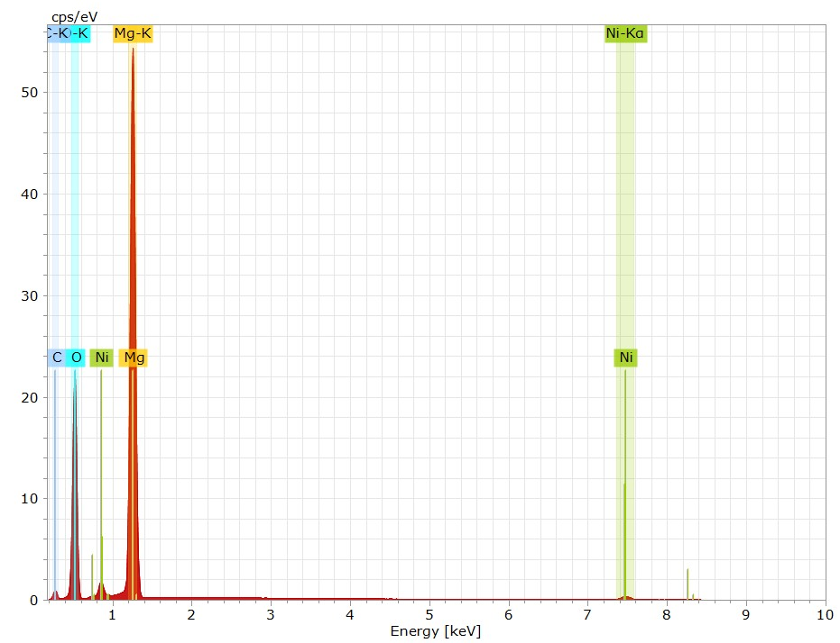
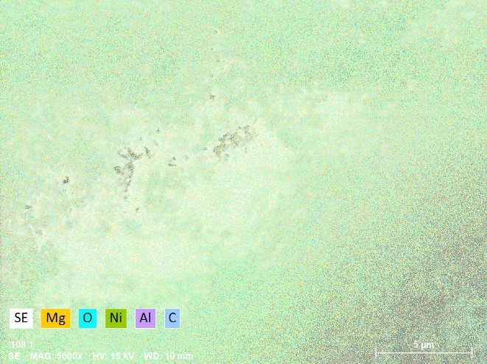
S36328 – map1
Element | Mass [%] | Mass Norm. [%] | Atom [%] | abs. error [%] (1 sigma) | rel. error [%] (1 sigma)
Oxygen | 43.1 | 42.5 | 54.1 | 1.8 | 4.1
Magnesium | 53.5 | 52.7 | 44.2 | 2.1 | 4.0
Nickel | 4.9 | 4.8 | 1.7 | 0.1 | 2.7
 | 101.6 | 100.0 | 100.0

Slide 7
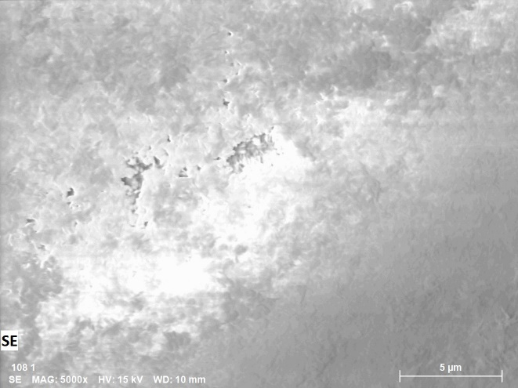
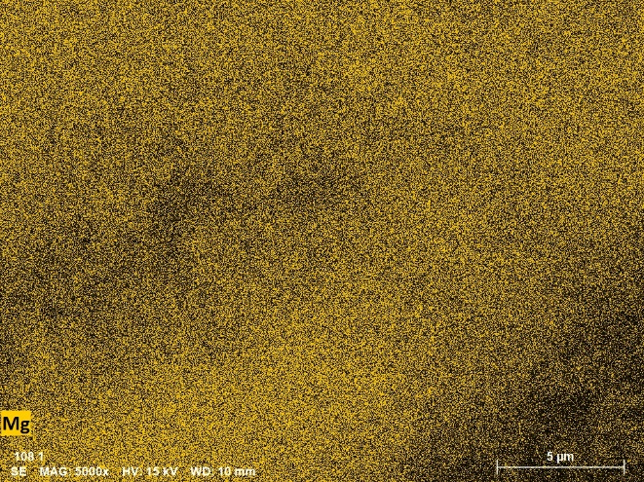
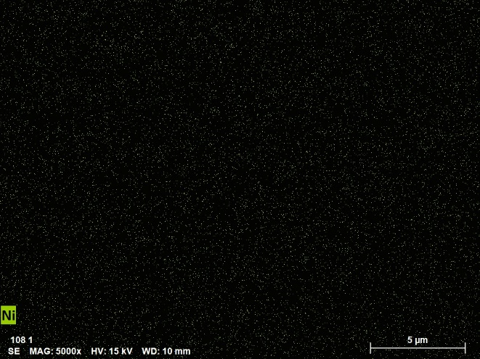
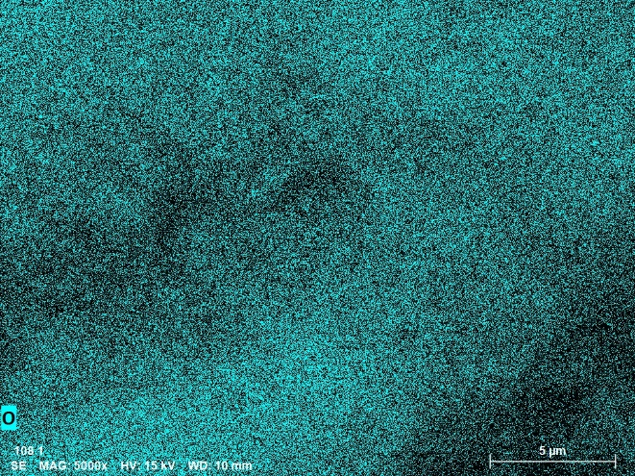
S36328 – map1

Slide 8
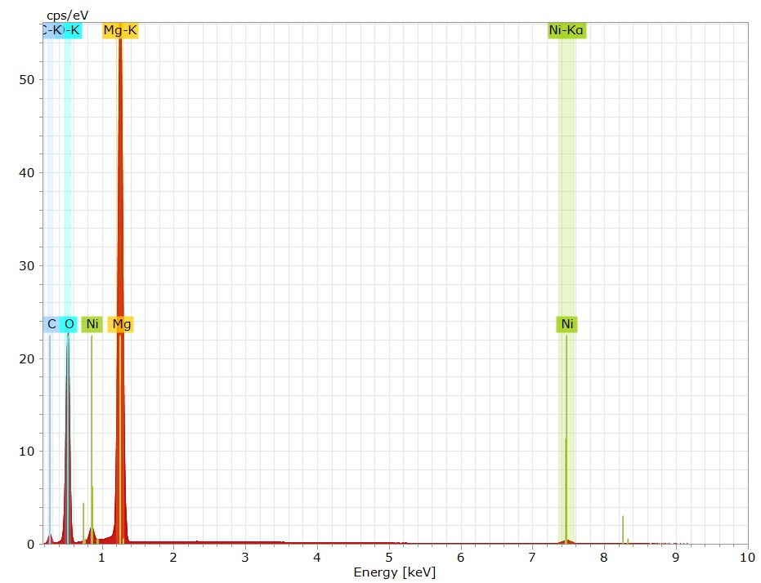
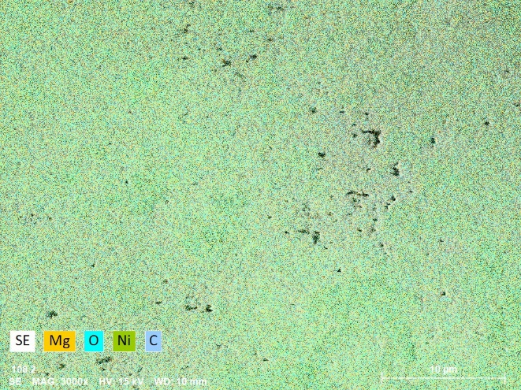
S36328 – map2
Element | Mass [%] | Mass Norm. [%] | Atom [%] | abs. error [%] (1 sigma) | rel. error [%] (1 sigma)
Oxygen | 43.9 | 41.1 | 52.6 | 1.8 | 4.1
Magnesium | 58.1 | 54.4 | 45.8 | 2.3 | 3.9
Nickel | 4.7 | 4.4 | 1.5 | 0.1 | 2.5
 | 106.8 | 100.0 | 100.0

Slide 9
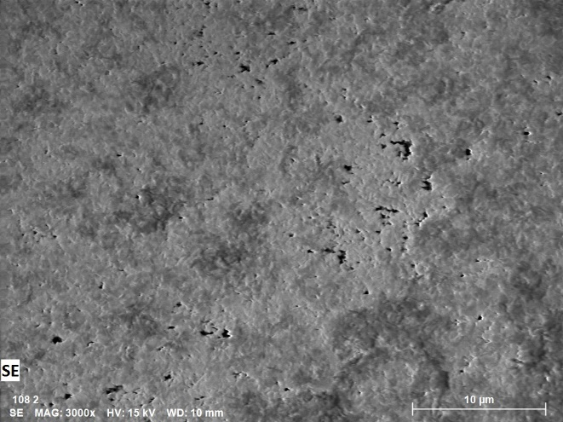
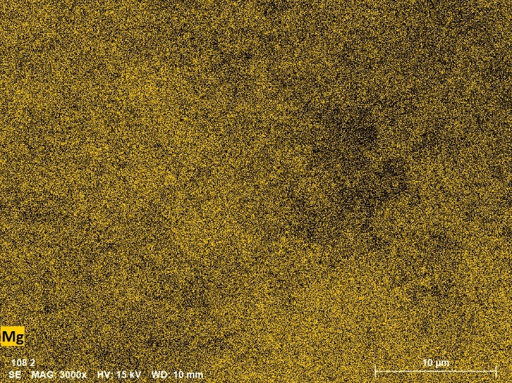
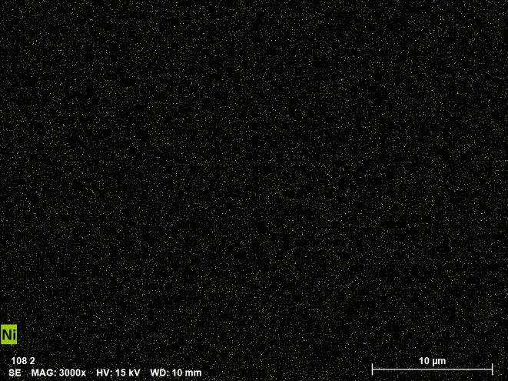
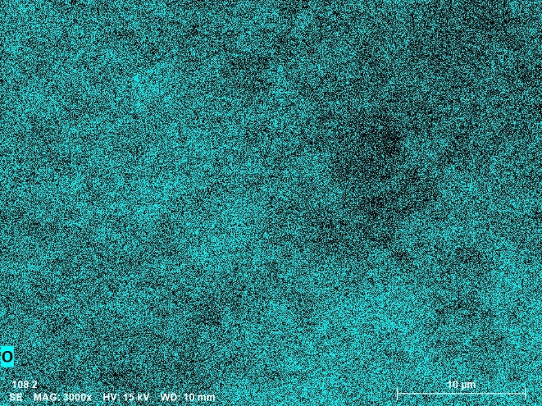
S36328 – map2

Slide 10
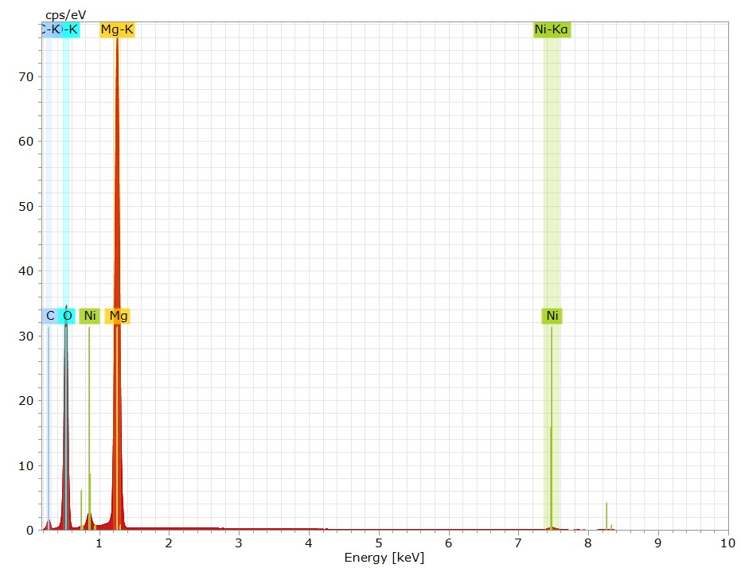
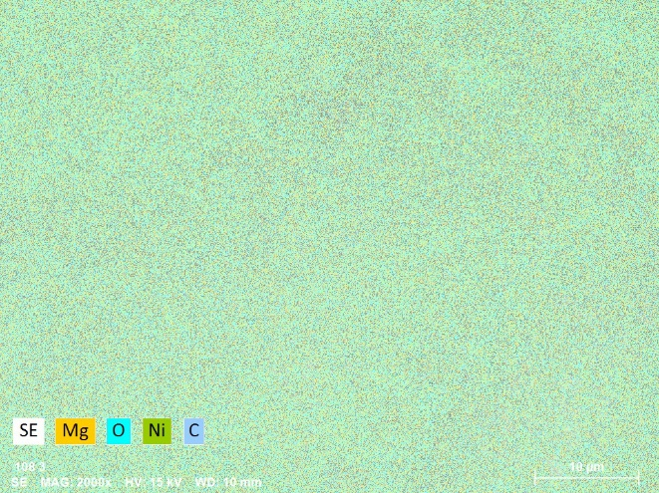
S36328 – map3
Element | Mass [%] | Mass Norm. [%] | Atom [%] | abs. error [%] (1 sigma) | rel. error [%] (1 sigma)
Oxygen | 44.2 | 45.2 | 57.0 | 1.8 | 4.1
Magnesium | 48.7 | 49.8 | 41.3 | 1.9 | 3.9
Nickel | 4.9 | 5.0 | 1.7 | 0.1 | 2.6
 | 97.8 | 100.0 | 100.0

Slide 11
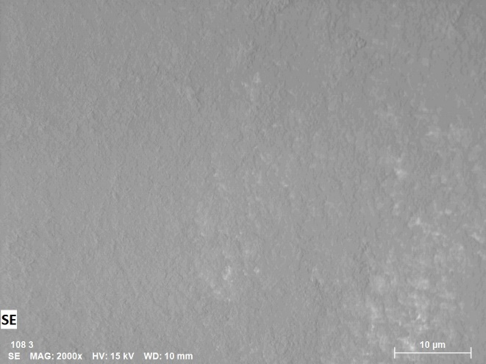
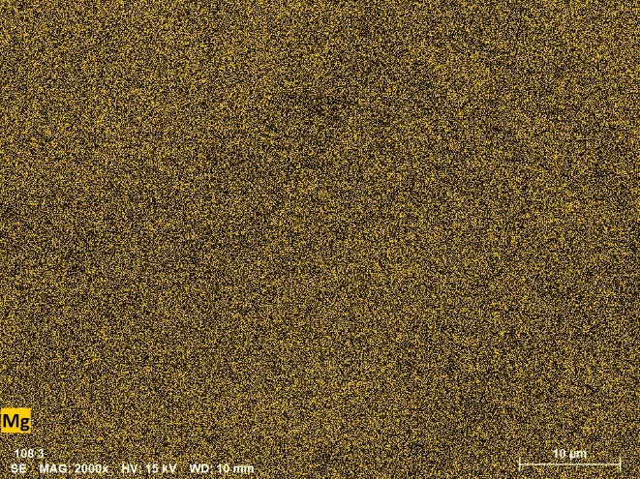
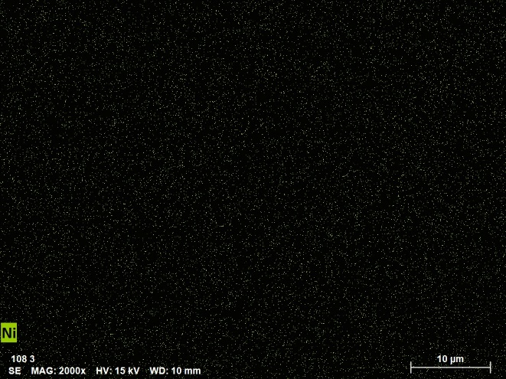
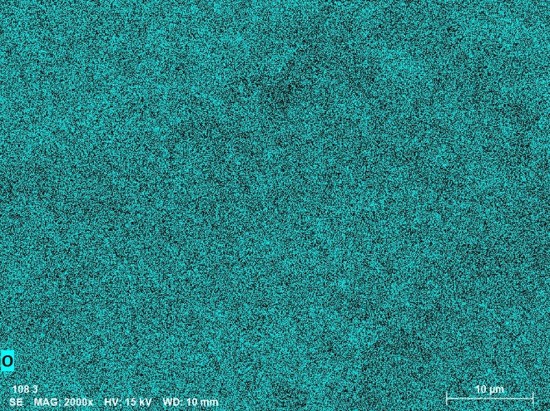
S36328 – map3
cubes

Slide 12
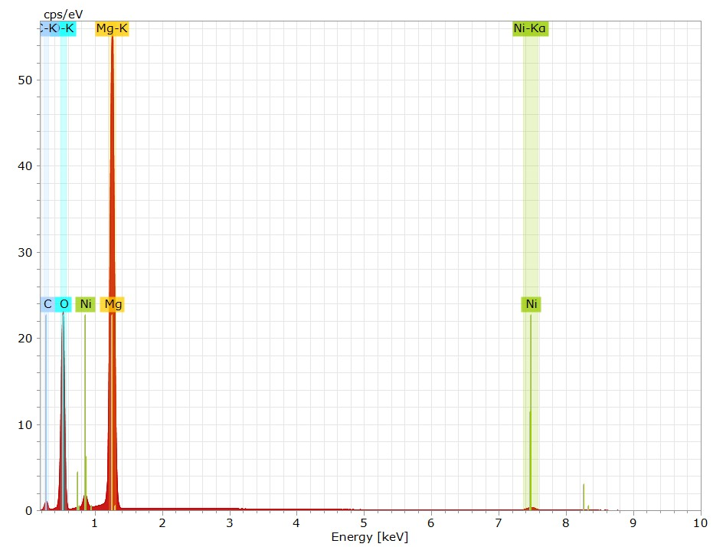
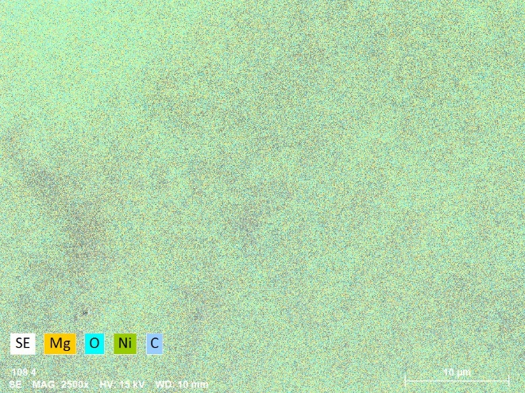
S36328 – map4
Element | Mass [%] | Mass Norm. [%] | Atom [%] | abs. error [%] (1 sigma) | rel. error [%] (1 sigma)
Oxygen | 43.0 | 42.5 | 54.1 | 1.8 | 4.1
Magnesium | 53.4 | 52.8 | 44.3 | 2.1 | 3.9
Nickel | 4.7 | 4.6 | 1.6 | 0.1 | 2.4
 | 101.0 | 100.0 | 100.0

Slide 13
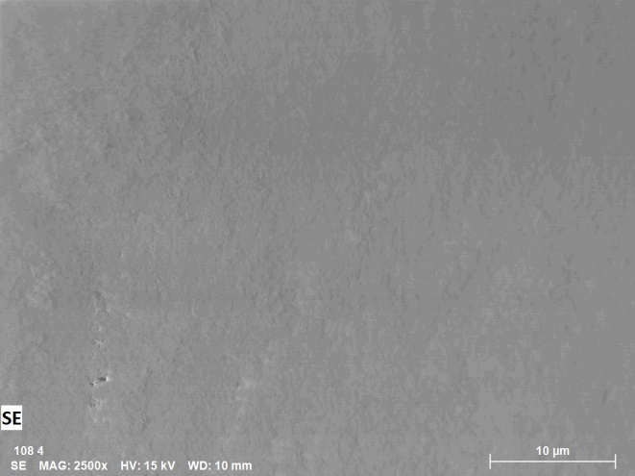
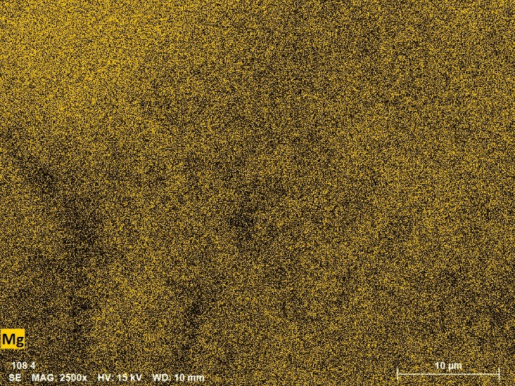
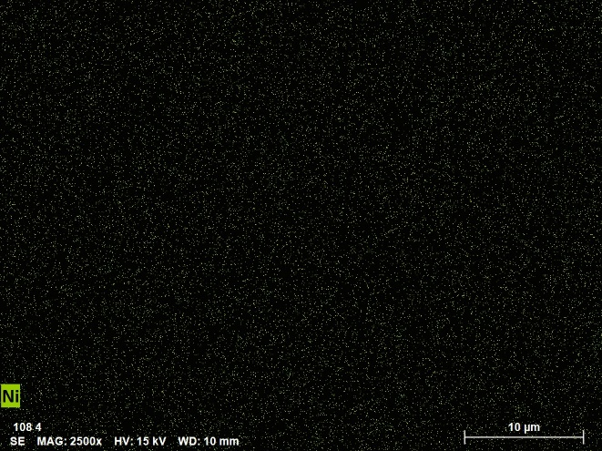
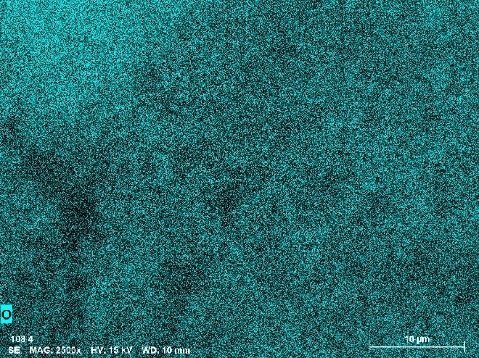
S36328 – map4

